Slide 1

2026 Wishlist

Slide 2
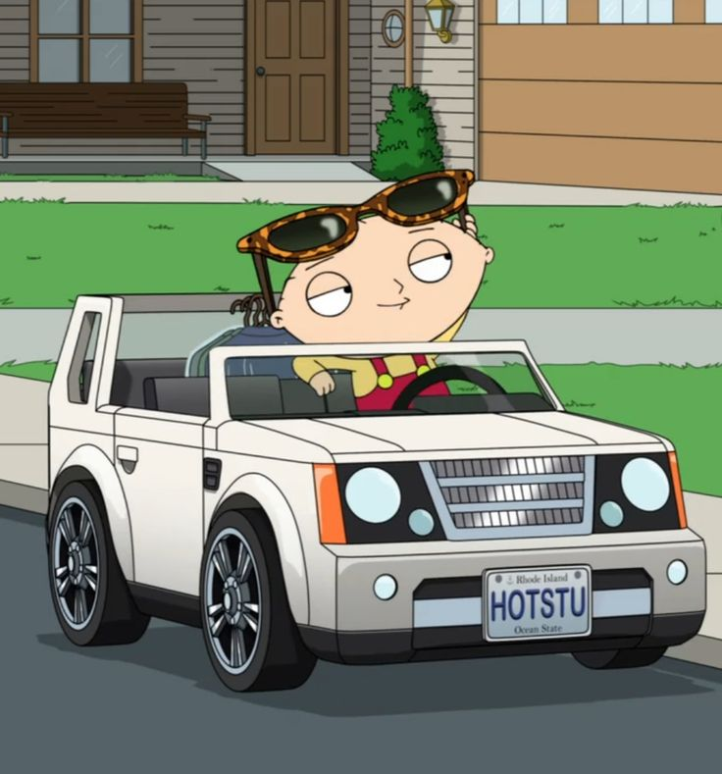
KEY
= Really want
Categories
Clothes
Items
Golf

Slide 3

Clothes

Slide 4
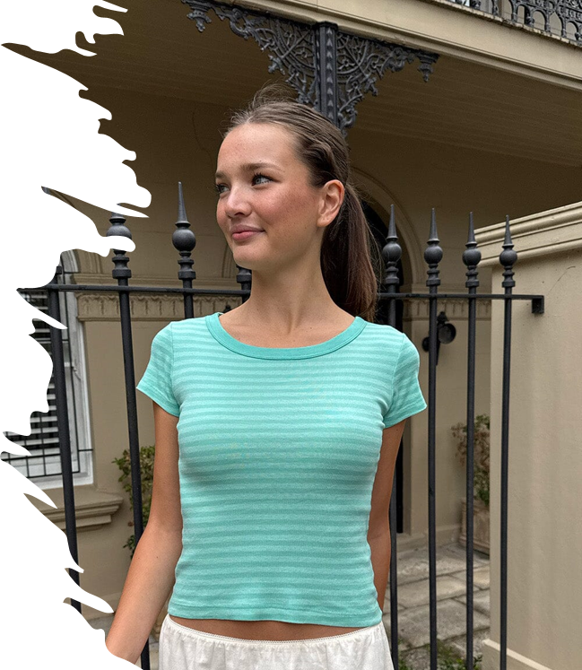
Ashlyn striped top price:$20 website: https://us.brandymelville.com/products/ashlyn-striped-top-3​

Slide 5
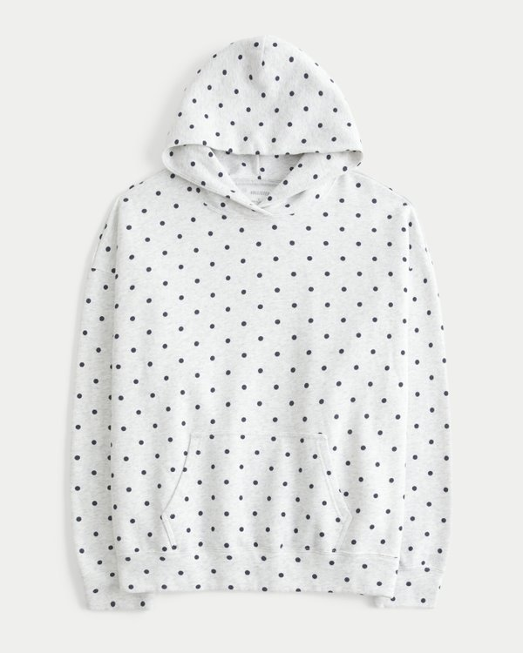
Hollister Feel Good Oversized Dot Hoodie​ price: $49.95
Size:xss
Website: https://www.hollisterco.com/shop/us/p/oversized-butterfly-graphic-hoodie-61735320?categoryId=614330491&faceout=model&seq=36&afsource=social+proofing&gridProductPosition=21​

Slide 6

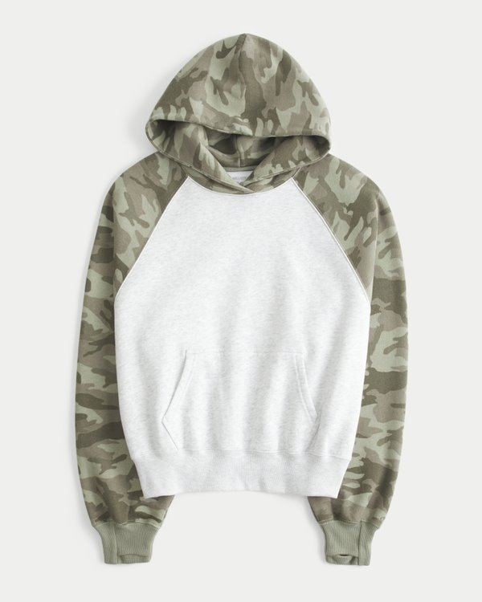
Hollister Feel Good Classic Fit Raglan Hoodie​
Price: $44.95
Size: xxs
Website: https://www.hollisterco.com/shop/us/p/hollister-feel-good-classic-fit-raglan-hoodie-63729321?categoryId=614330491&faceout=model&seq=01&gridProductPosition=77​

Slide 7
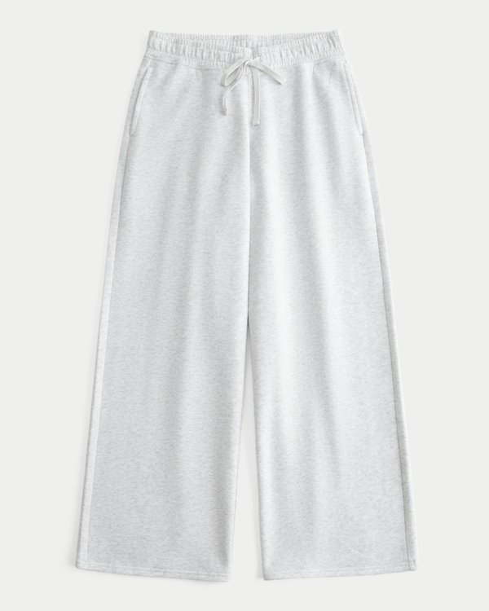
Hollister Feel Good California Graphic Bootcut Sweatpants​
Price:$44.99
Size: xxs length: regular
Website: https://www.hollisterco.com/shop/us/p/hollister-feel-good-low-rise-baggy-sweatpants-63157828?categoryId=614330491&faceout=model&seq=11&gridProductPosition=22​

Slide 8
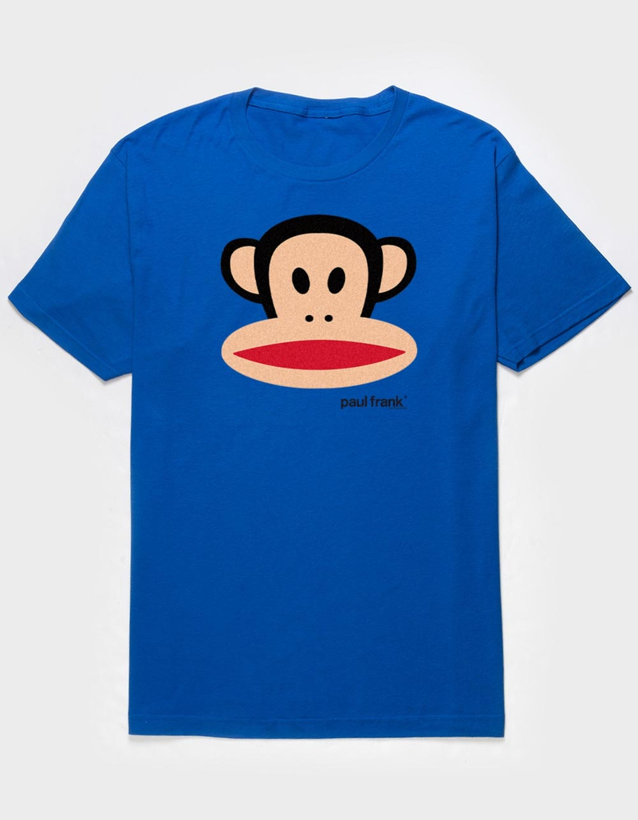
PAUL FRANK Julius Head Unisex Tee
Price: $24.99
Website: https://www.tillys.com/product/paul-frank-julius-head-unisex-tee/530803215.html?utm_source=Pinterest&utm_medium=organic&epik=dj0yJnU9akRtQXZHb25JZXhETGg2eVVKUGYwS3RxYXRtMktrcHImcD0wJm49ZHNSc1Z3R3ZVM2pZdE90S1ViN0xWdyZ0PUFBQUFBR3JWRVFn

Slide 9
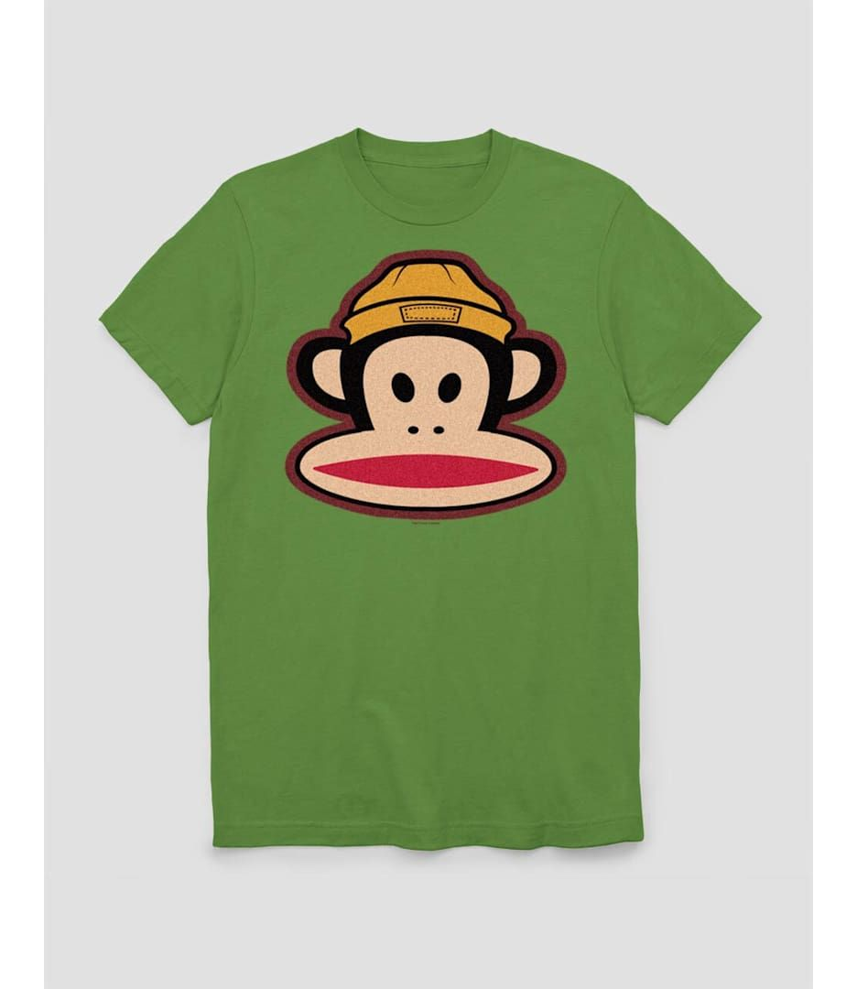
Website: https://www.tillys.com/product/paul-frank-julius-beanie-unisex-tee/455146501.html?utm_source=Pinterest&utm_medium=organic&epik=dj0yJnU9eEF1VHRRMk5VZlBTRGNVSDRzRjJPeEJUZnlQOUZvNjAmcD0wJm49UXhhLXZ3ZGZqVEo0NFFoUHdIUWpTdyZ0PUFBQUFBR3JWRWpB
PAUL FRANK Julius Beanie Unisex Tee
price:$24.99

Slide 10
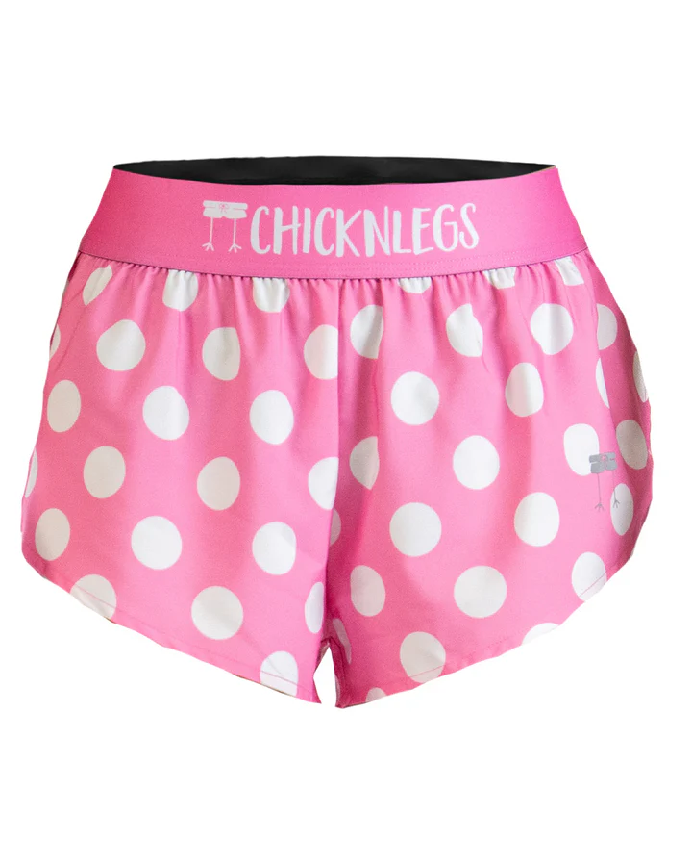
Women's Nuggets 1.5" Split Shorts
Price: $35.00
Size: XXS
Website: https://www.chicknlegs.com/products/womens-pink-polka-dot-1-5-split-shorts?variant=47431976026368

Slide 11
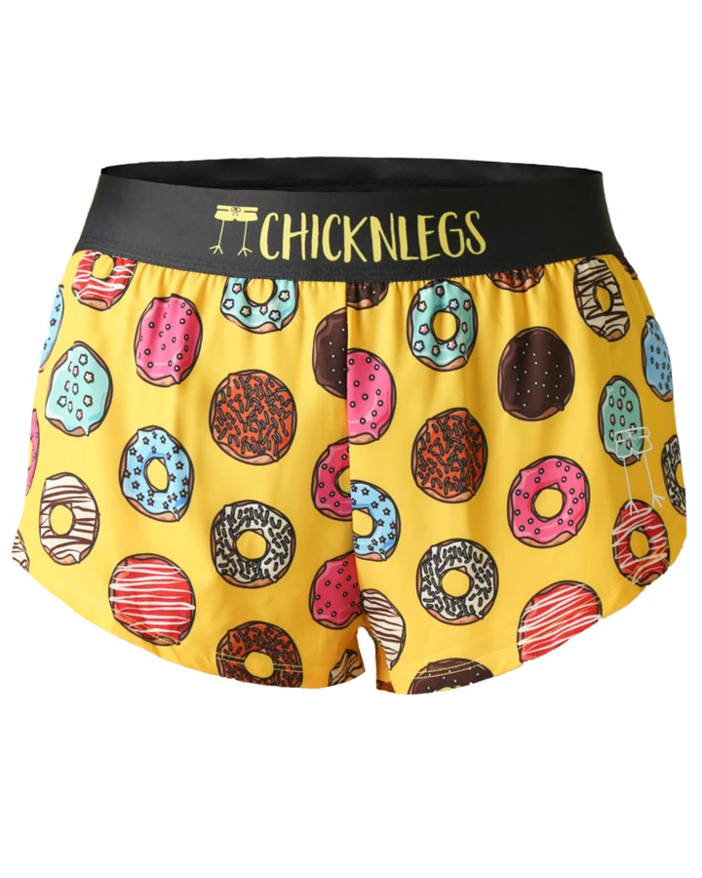
Women's Nuggets 1.5" Split Shorts
Price: $35.00
Size: XXS
Website: https://www.chicknlegs.com/products/chicknlegs-donuts-1-5-run?variant=43365343723776

Slide 12
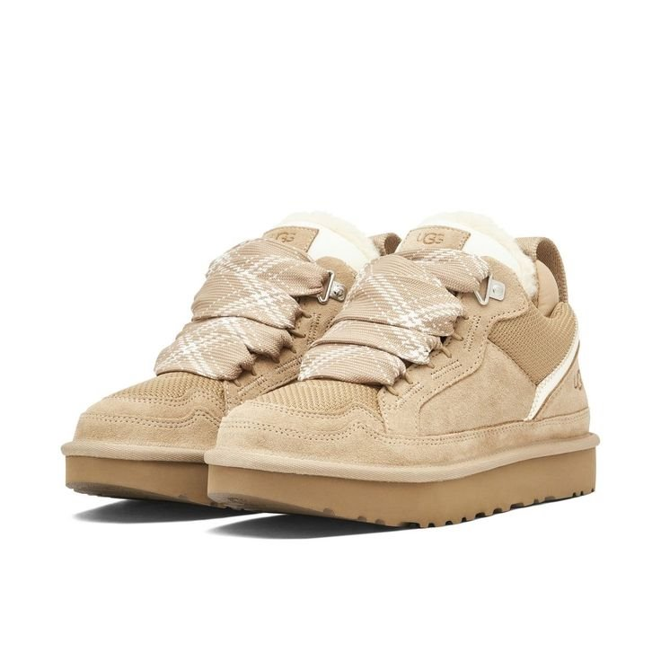
Women's Lowmel​ price:$150
Size: Women’s 5.5
Website: https://www.ugg.com/women-casuals-sneakers/lowmel/1144032.html?dwvar_1144032_color=SAN​

Slide 13
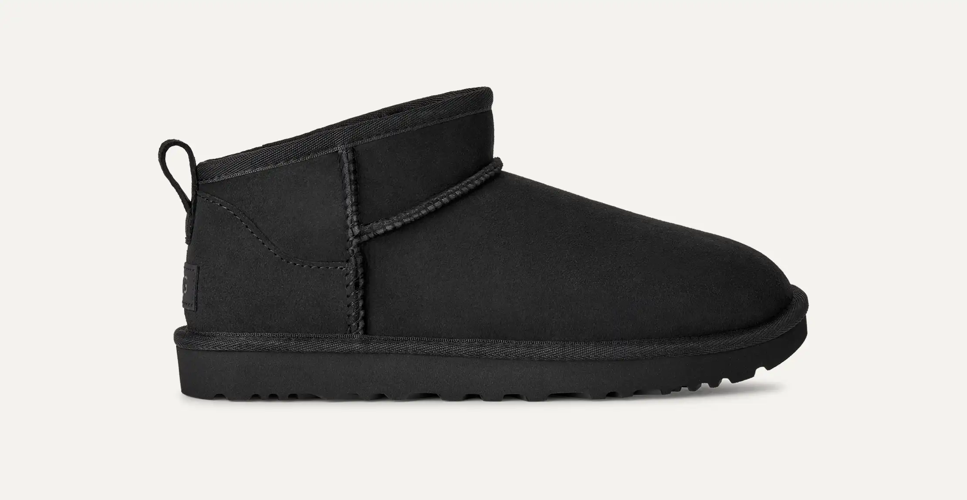
Women's Classic Ultra Mini
Price:$109.99 109.99 USD- $165
Website: UGG
Size: Women 5.5

Slide 14
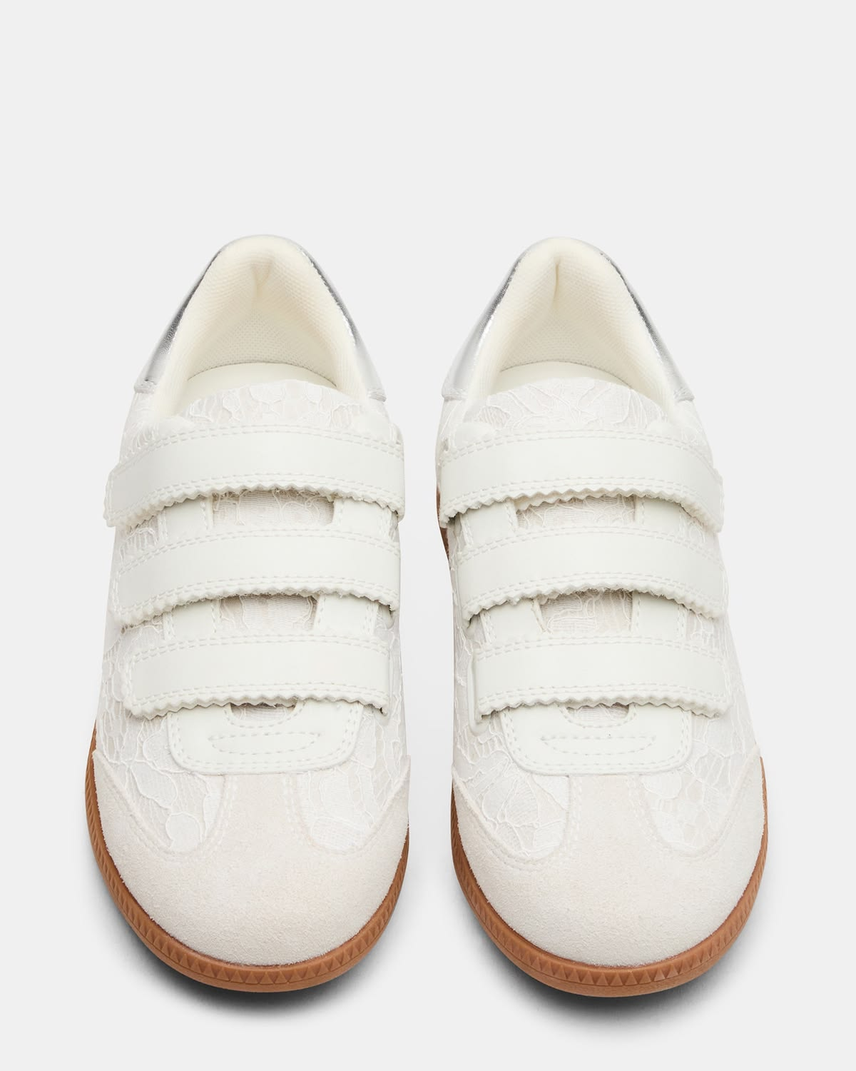
Women's Momentum Low-Top Sneakers White Lace
Price: $75
Size: Women’s 5.5
Website: Steve Madden

Slide 15

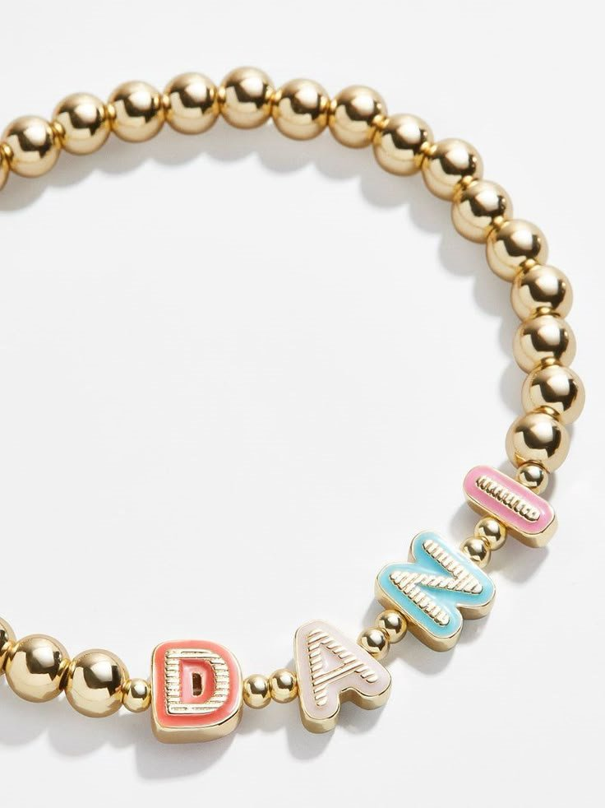
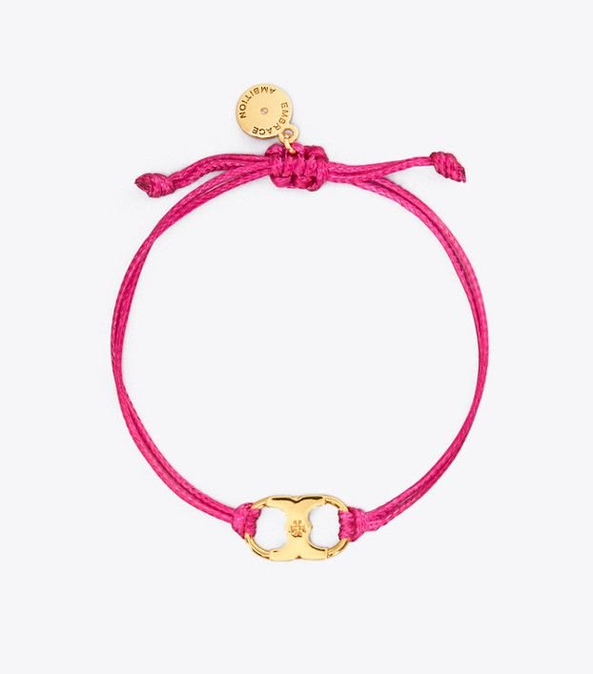
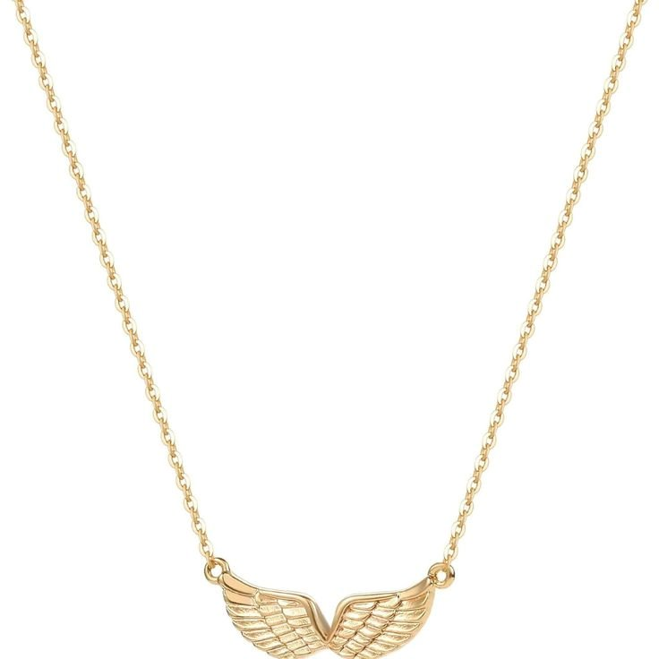
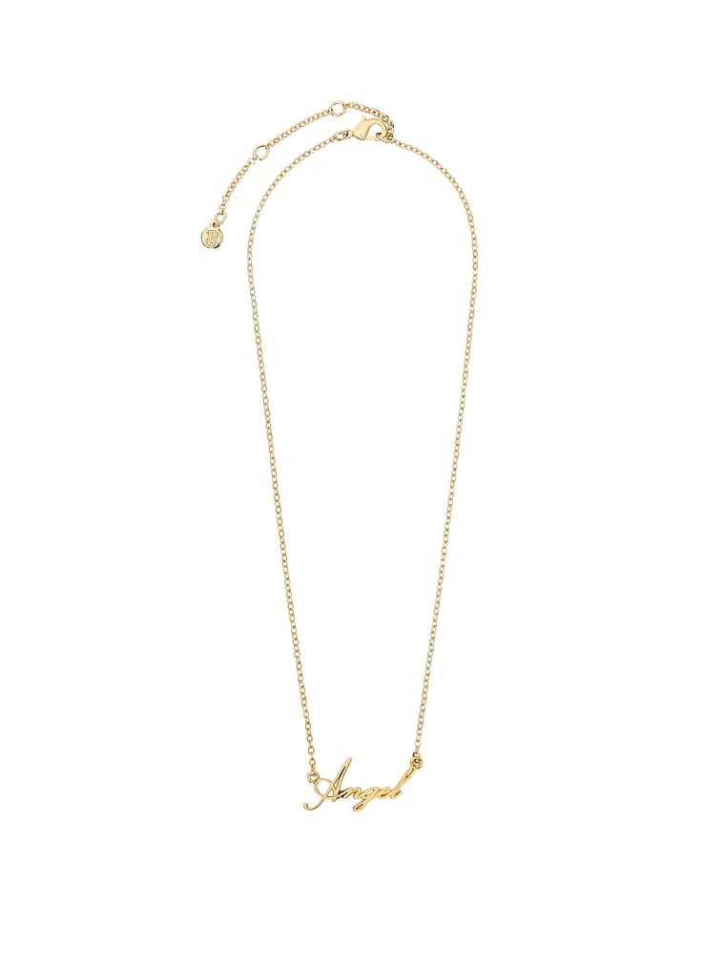

Jewelry
Enamel Pisa Custom Bracelet - Multi​ | EMBRACE AMBITION BRACELET​ ​ | Gold Angel Wings Pendant Necklace​ | VS Angel Nameplate Necklace
Price: $44.00 | Price: $30.00 | Price: $33 | Price:???
Website: Bubble bar​ | ​Website: tory Burch | Website: amazon | Website: Victoria secret
ARI

Slide 16
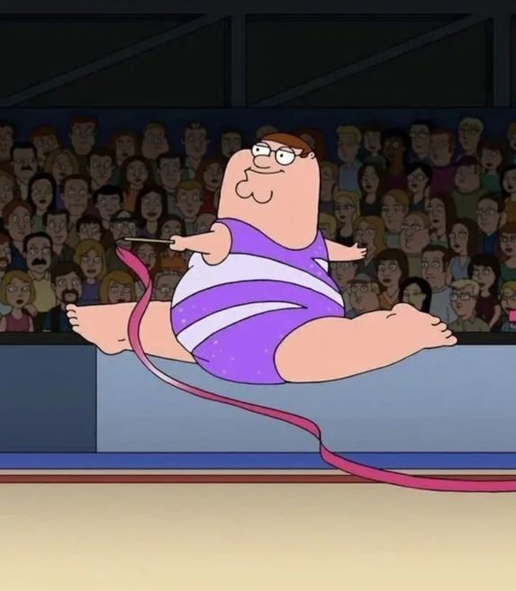
Items

Slide 17
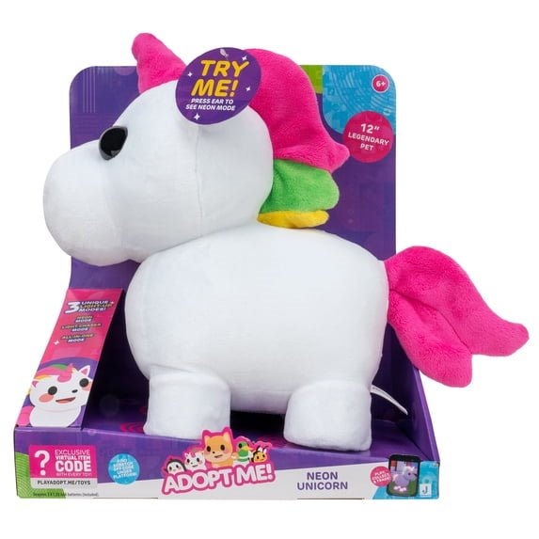
Adopt Me! Neon Unicorn Light-Up Plush - Soft and Cuddly - Three Light-Up Modes - Toys for Kids​
Price: $26.91
Website: https://www.walmart.com/ip/Adopt-Me-Neon-Unicorn-Light-Up-Plush-Soft-and-Cuddly-Three-Light-Up-Modes-Toys-for-Kids/1994804582​

Slide 18
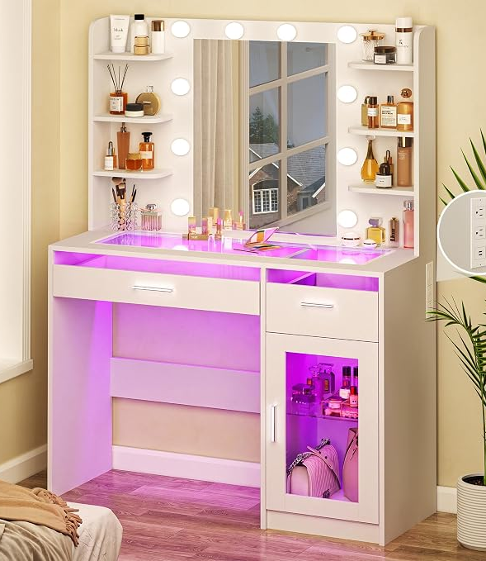
HUAHUU Vanity Desk with Mirror and Lights, Makeup Vanity Desk with Lights 3 Colors, Transparent Top Vanity with 2 RGB Drawers, 6 Shelves, Large Tempered Cabinet, Power Outlet, for Bedroom, White price: $129.89
Color: white
Really want
Website: amazon

Slide 19
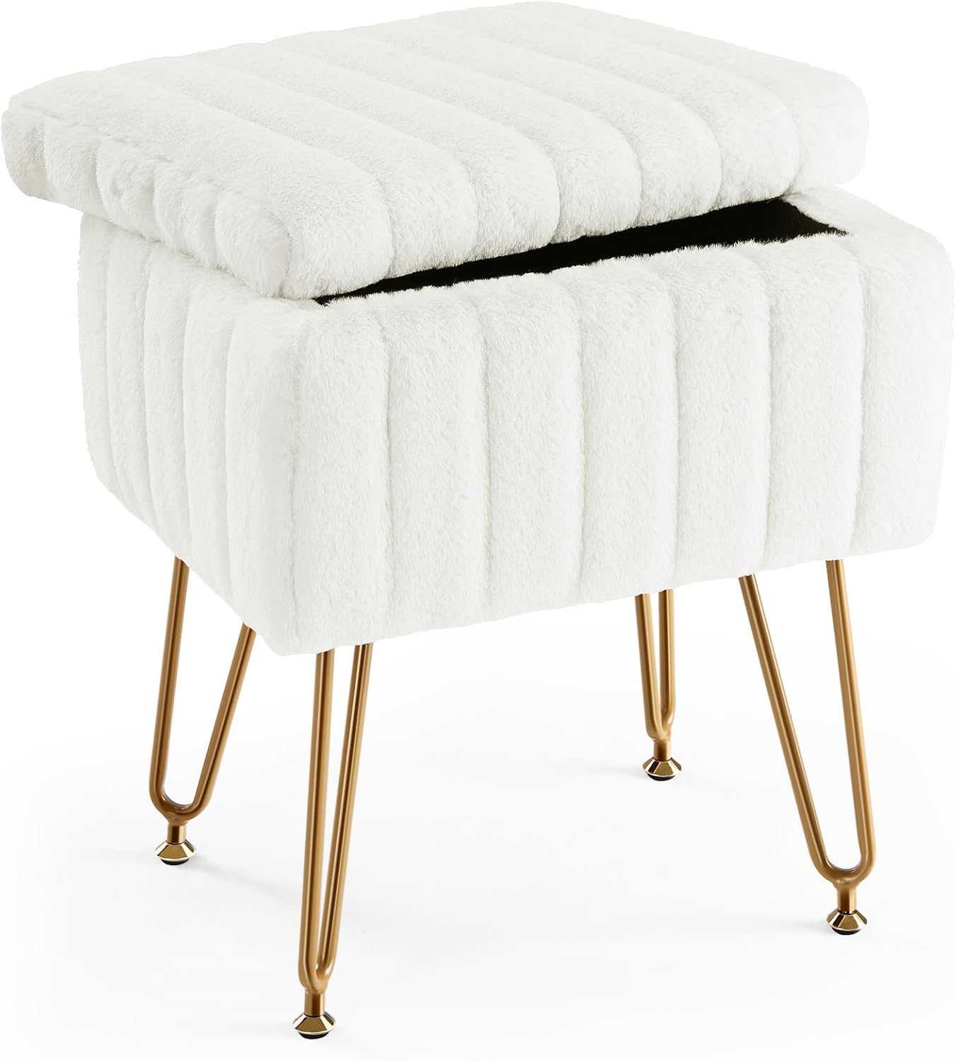
Sweetcrispy Vanity Stool Chair with Storage, Ottoman Faux Fur Soft Padded Makeup Footstools Seat with 4 Metal Legs Anti-Slip Adjustable Feet Modern Cute Small Footrest for Home Entryway Bedroom White
Price: $28.80
Website: Amazon

Slide 20
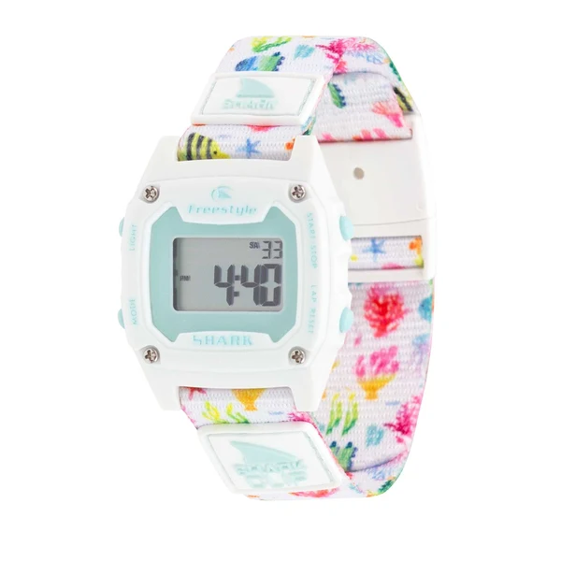
REEF LIFE
PRICE:$70
WEBSITE:https://www.freestyleusa.com/products/shark-mini-clip-reef-life

Slide 21
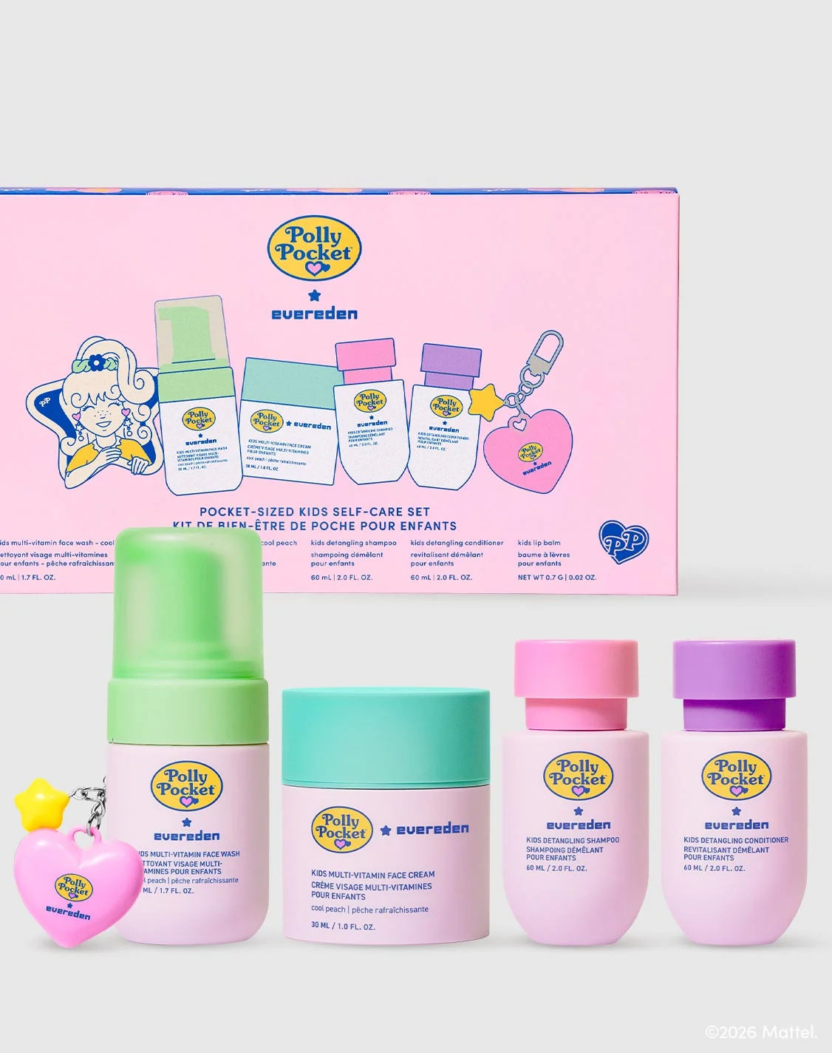
Polly Pocket™ Kids Self-Care Set
Price: $69
Website: https://www.ever-eden.com/products/polly-pocket-kids-self-care-set

Slide 22
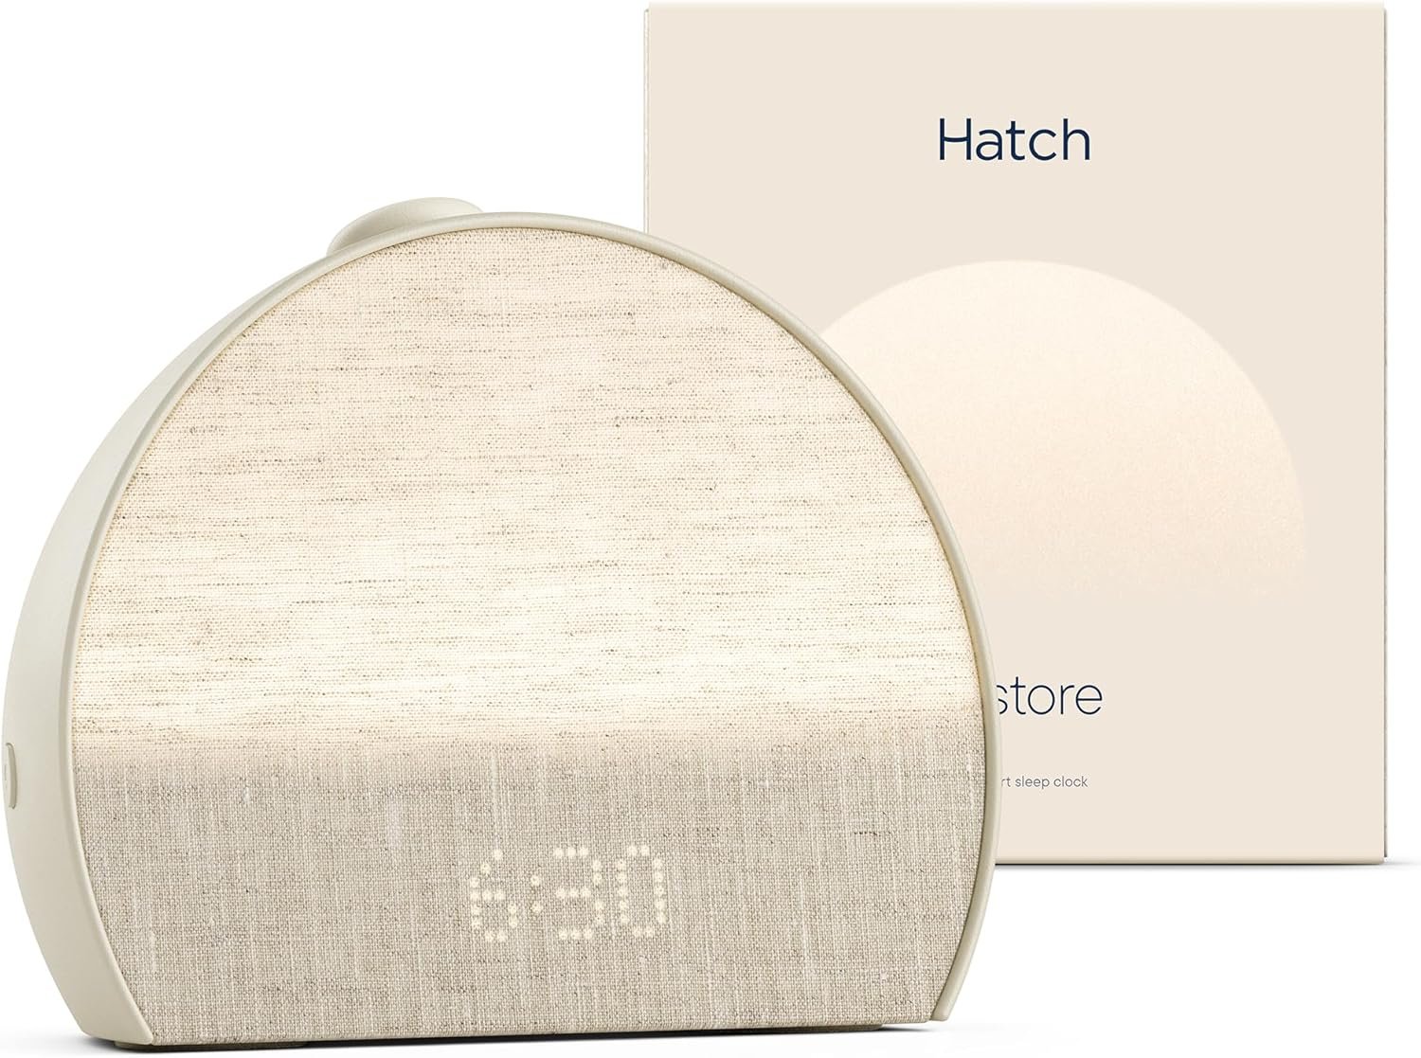
Hatch Restore 3 | Science-Backed Sleep Audio, Circadian Lighting (Putty)
Price: $169.99
Website: Amazon

Slide 23
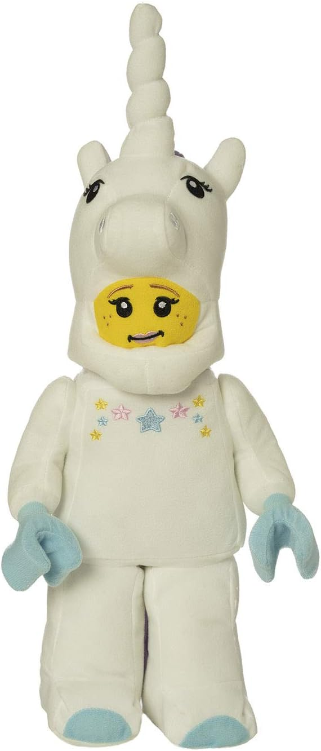
LEGO Minifigure Unicorn Girl 17" Plush Character
PRICE: $32.99
Website: Amazon

Slide 24
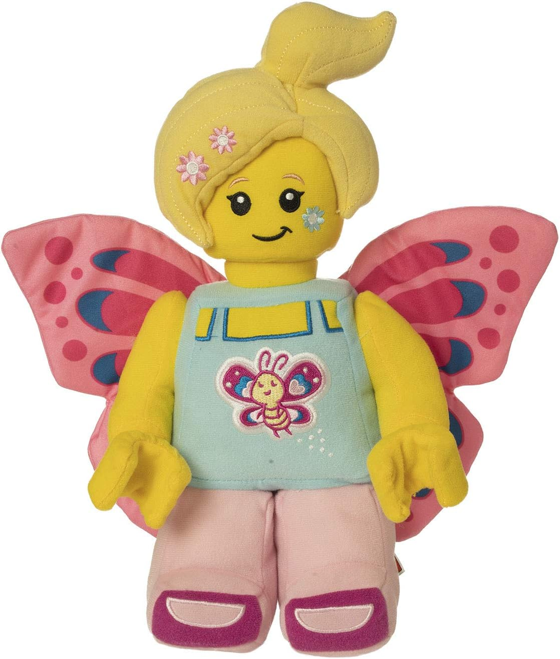
Lego Minifigure Butterfly Girl with Flowers 12" Plush Character price:$32.99
Website: Amazon

Slide 25
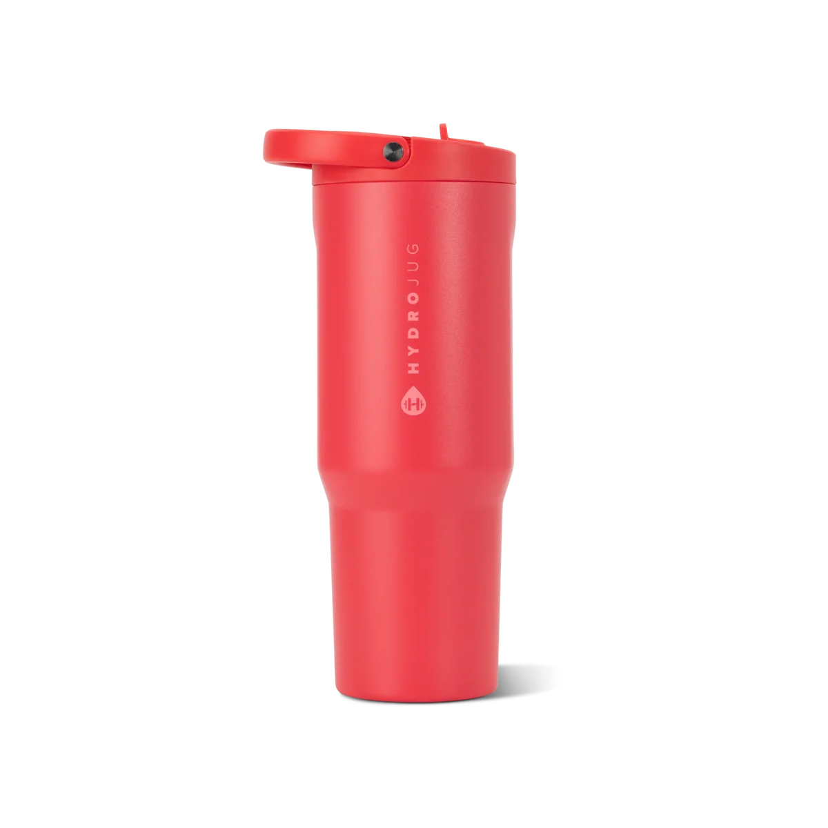
Fruit Punch
Price: $36.00
Size: 40oz
Website: https://www.thehydrojug.com/products/fruit-punch-40oz-sport

Slide 26
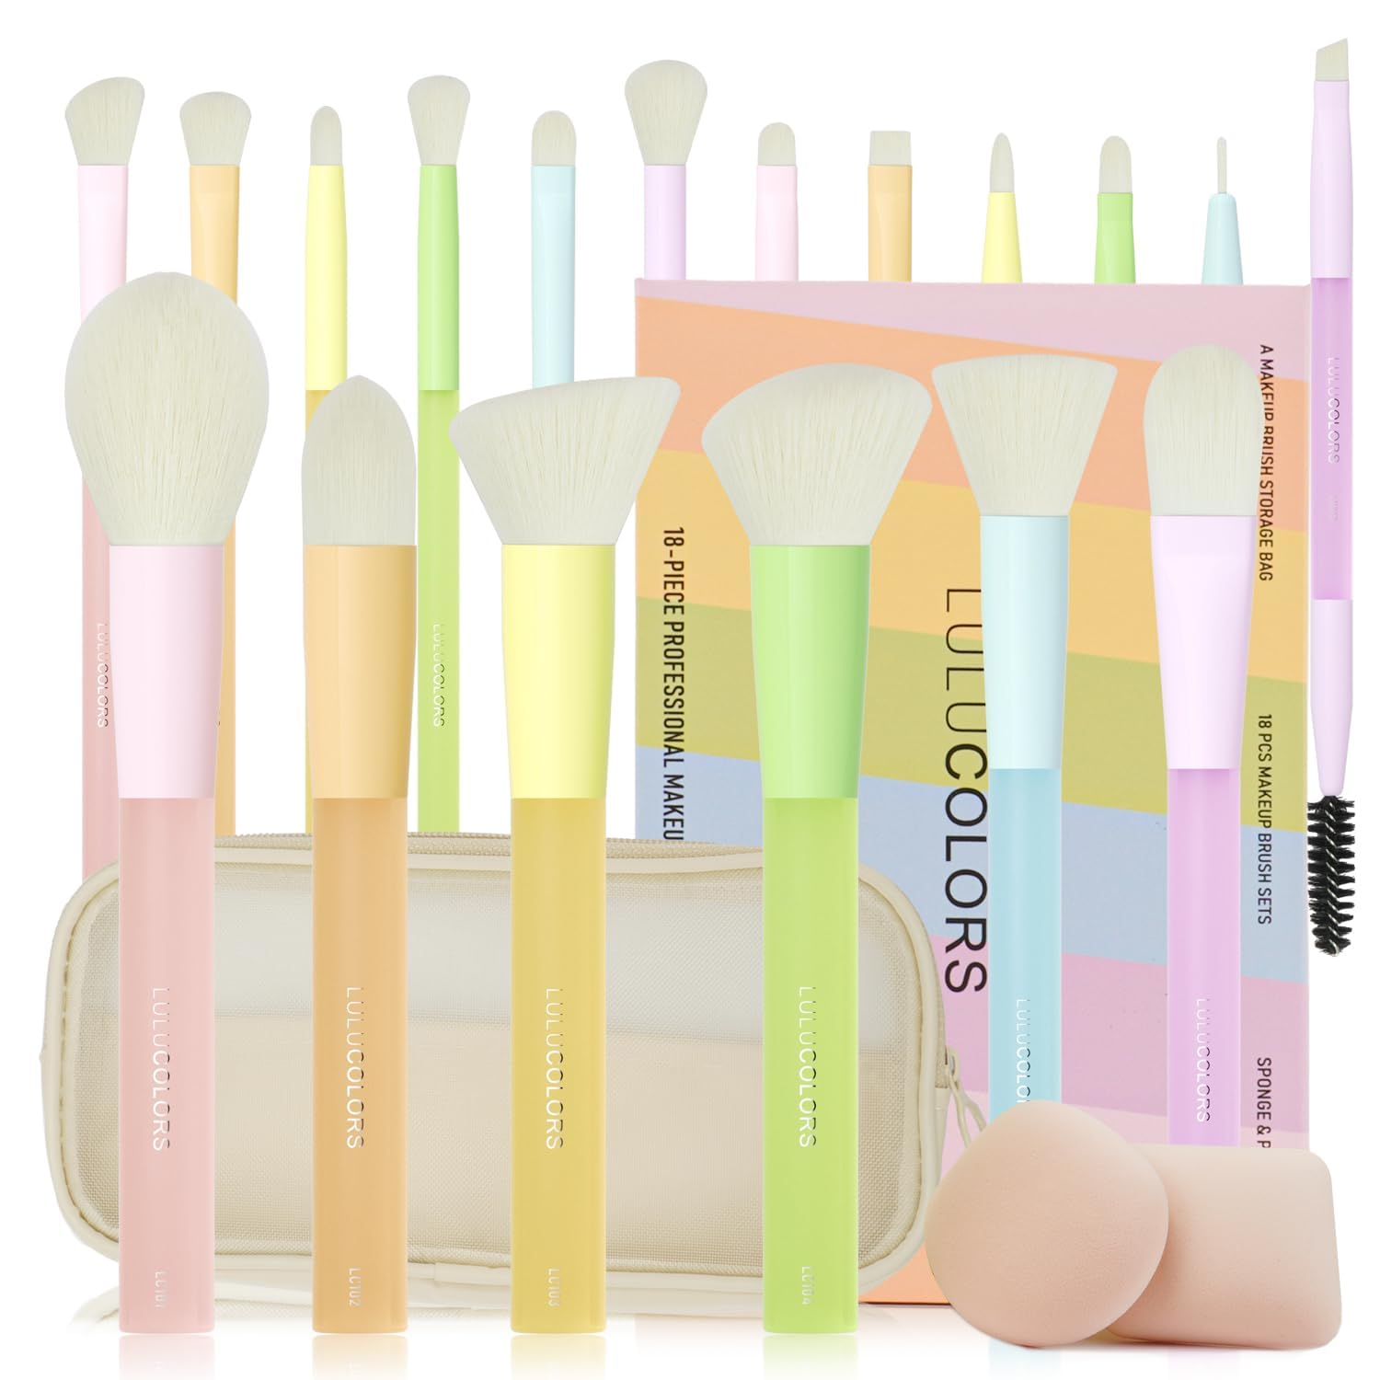
LULUCOLORS 18Pcs Candy‑Colored and Soft Touch Makeup Brush Set
Price: $19.89
Website: Amazon

Slide 27

Golf stuff

Slide 28
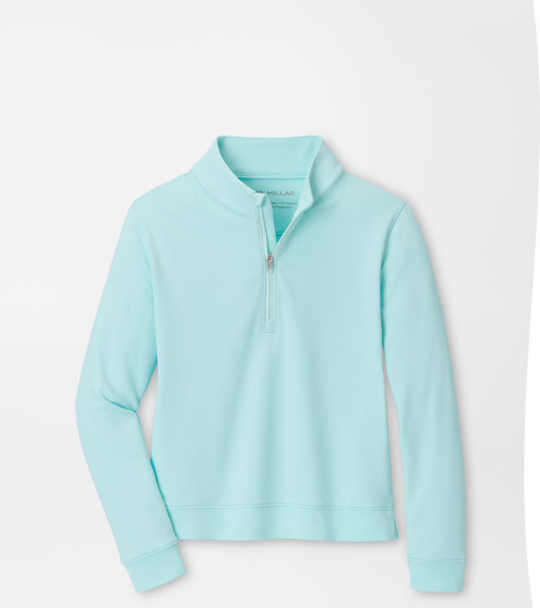
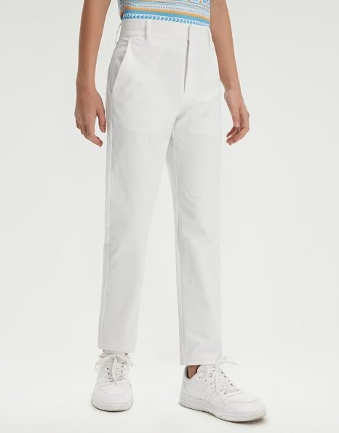
Golf clothes
M MAELREG Boys Golf Pants Stretch Flat Front Dress Athletic Casual Youth Golf Pants School Uniform Pants with Mesh​
Price: $29.95
Size: 10-11
Website: https://www.amazon.com/MAELREG-Uniform-Pants-Performance-Resistant/dp/B0GF24SGBJ/ref=sr_1_5?crid=10772O64PLDIQ&dib=eyJ2IjoiMSJ9.Qh-BsGZFzTbGRvza_YdQJynVh2Y6B_dvhHmtZWqYjZk0iJxETA9xeOjCBmgAIEf2S8912pynC15YbVAibYuTi6XOeK_o2OKJHUZleOKP647VOcBodUCMKMQDxkPr72xTQIS6t31AXKJz1w4ubU-SsP90Xly2ZDXFYyg336XgGyzcFd3auUT9OXeFzfeVK8Lny-IBi4gEUsaaYmtcQ7SCt9gG0jafQeMk4je4S-hqen2JR5Z4_6W8RD_pL7Avge11JKbchEIDkq2nIvZmxFYcPPizduhr7m-rJQhGOQtW7XY.7M8zICkQhtC4RiKxXwRZahnoWMz2RG5tXUwpddFzNrQ&dib_tag=se&keywords=golf%2Bwhite%2Bpants%2Bgirls&qid=1789995327&s=sporting-goods&sprefix=golf%2Bwhite%2Bpants%2Bgirls%2Csporting%2C158&sr=1-5&th=1&psc=1​
​
Girls Perth Performance Quarter-Zip​
Price: $75
Size: Large
Website: https://www.petermillar.com/p/girls-perth-performance-quarter-zip/ygf26ek40_OCNAR.html?dwvar_ygf26ek40_color=OCNAR​

Slide 29
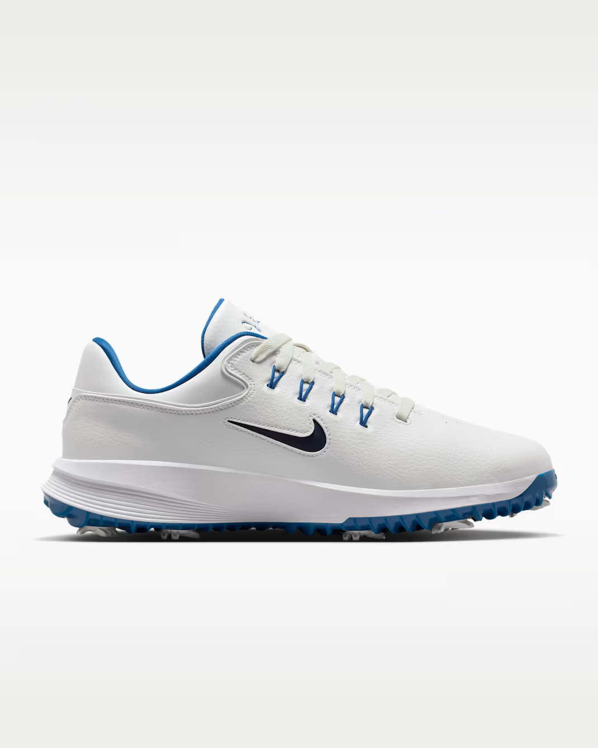
Nike Victory Pro 4
Color: Summit White/Court Blue/Metallic Silver/Obsidian
Size: Men 4 /Women’s 5.5
Website: Nike

Slide 30
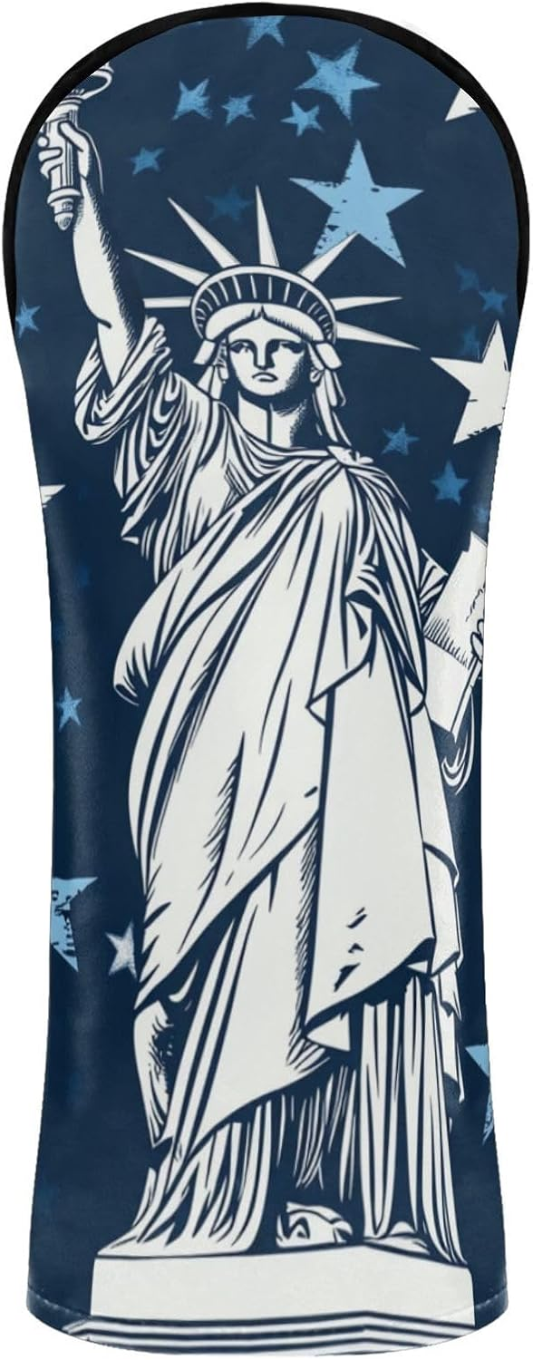
Golf Club Covers Driver Head Covers Wood Cover Hybird Headcovers Set Leather Golf Accessories with Sof Lining
Price: $14.99
Website: Amazon
(wood)

Slide 31
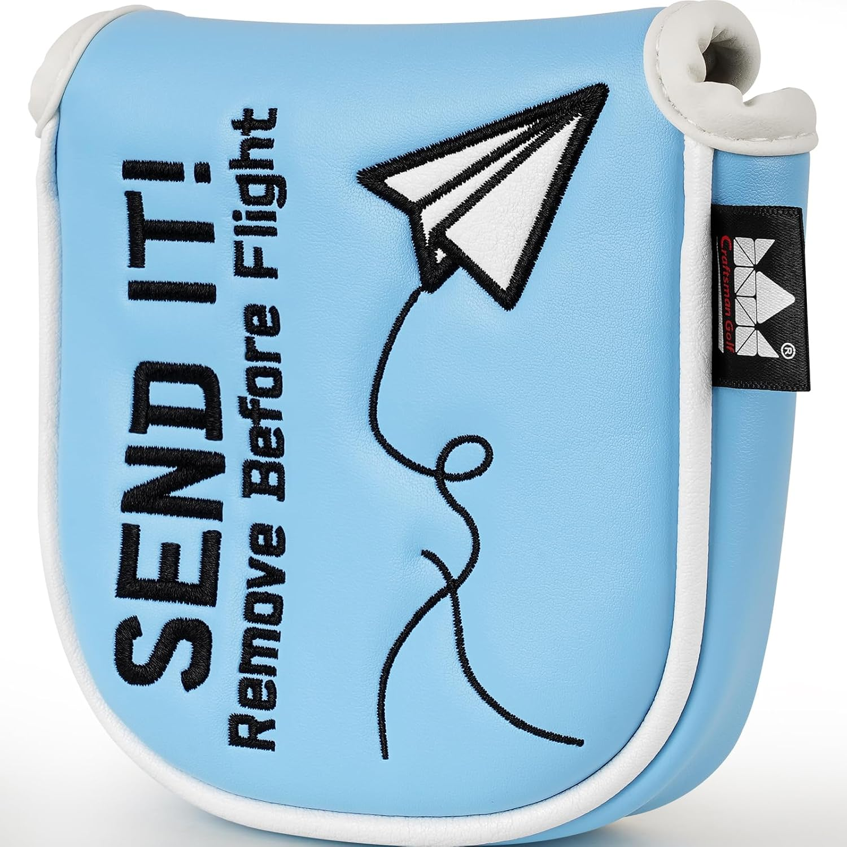
Craftsman Golf Airplane Send It 460cc Blue Driver Headcover Fairway Wood Hybrid Mallet Blade DF3 OZ.1 Putter Head Covers Alignment Stick Protector
Price: $14.99
Website: Amazon

Slide 32
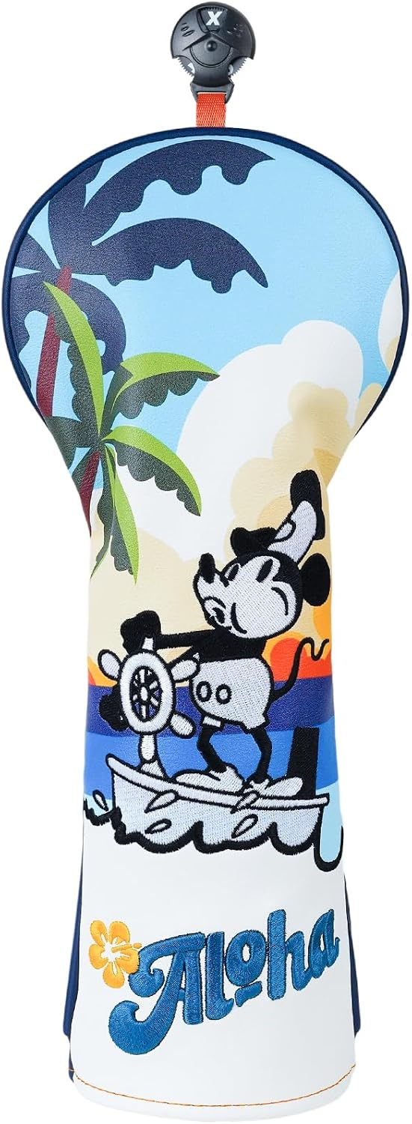
Golf Club Head Cover Golf Head Cover Driver Headcover Fairway Wood Headcover Hybrid Club Head Cover
Price: $21.99
Website: Amazon

Slide 33
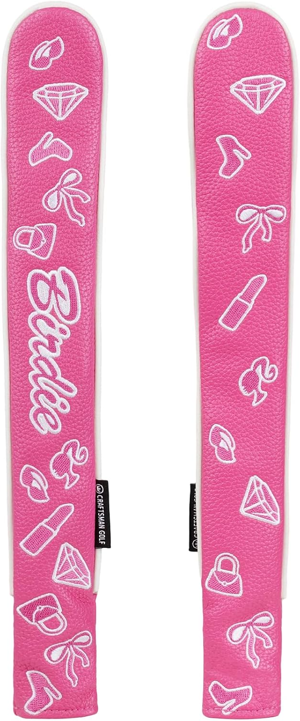
Craftsman Golf Pink Birdie Girly Style Golf Driver Headcover Mallet Blade Putter Covers OZ.1 MEZZ.1 MAX Gift for Women
Price: $19.99
Website: Amazon

Slide 34
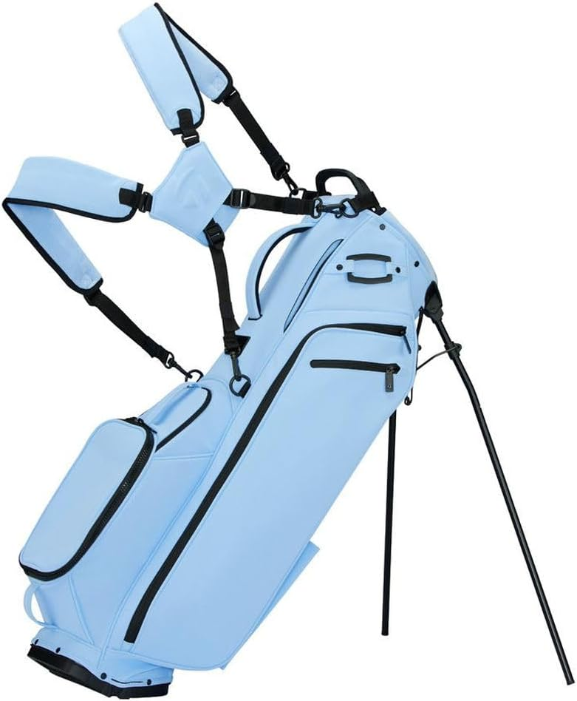
TaylorMade Signature M4 Stand Bag
Price:356.00
Website: Amazon or TaylorMade
Click on 2 times the next slide

Slide 35
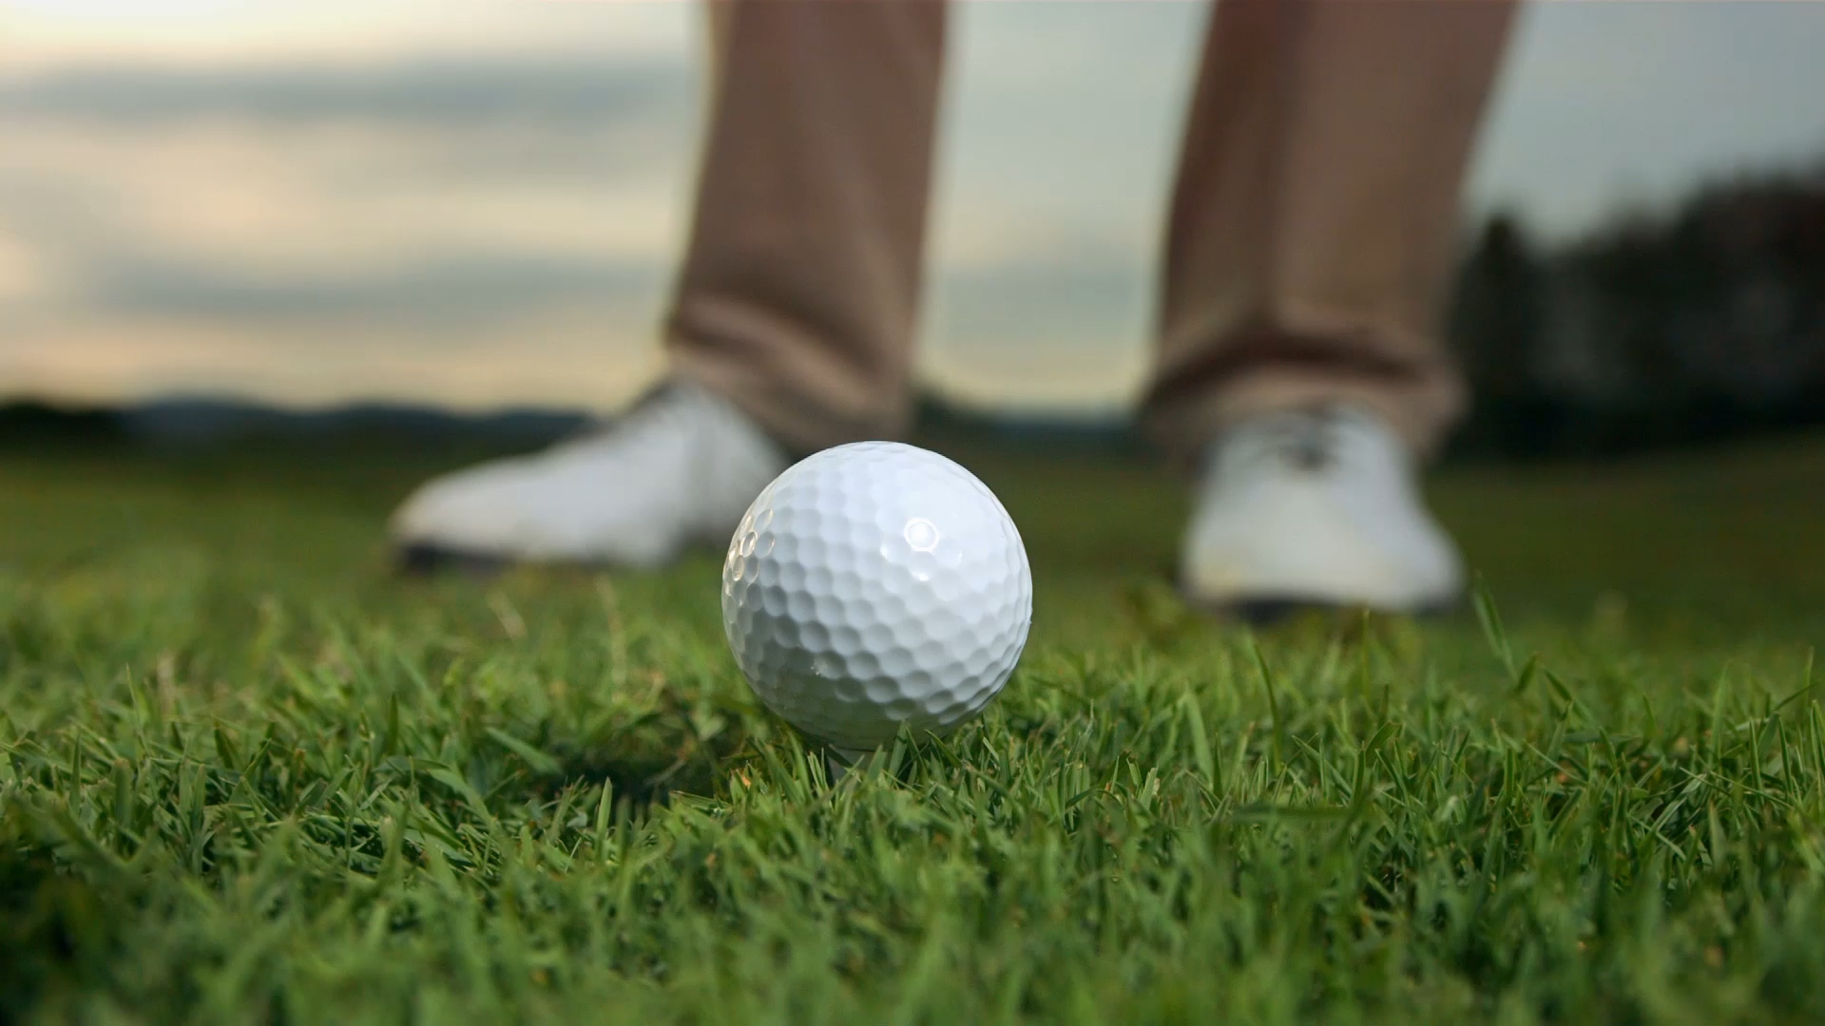
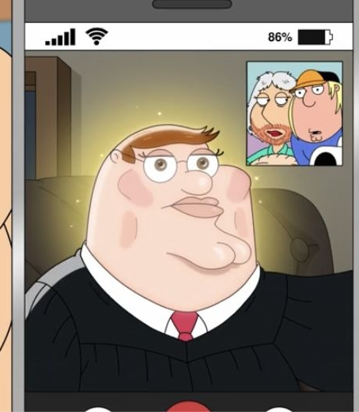
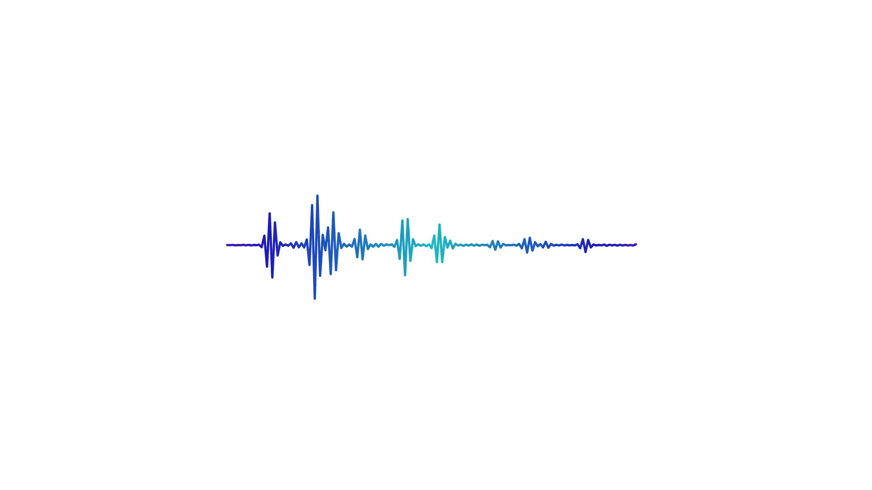
THANK YOU
Thank You for viewing

